Slide 1

The Agent Broke It,
the Agent Fixed It
Self-healing progressive delivery on Kubernetes
Carlos Sanchez
Kevin Dubois
Principal Scientist, Adobe
Sr. Principal Developer Advocate, IBM
github.com/carlossg linkedin.com/in/carlossg
github.com/kdubois linkedin.com/in/kevindubois
Notes:
Twenty-five minutes, and about half of it is a live demo. Carlos opens, Kevin runs the demo on the cluster. Set the frame here: this is not a talk about AI writing code. It is about what happens after AI-written code reaches production, and why the same agent that shipped the bug can be the one that finds it and fixes it. Everything shown runs on open source: Argo CD, Argo Rollouts, Quarkus, LangChain4j.

Slide 2
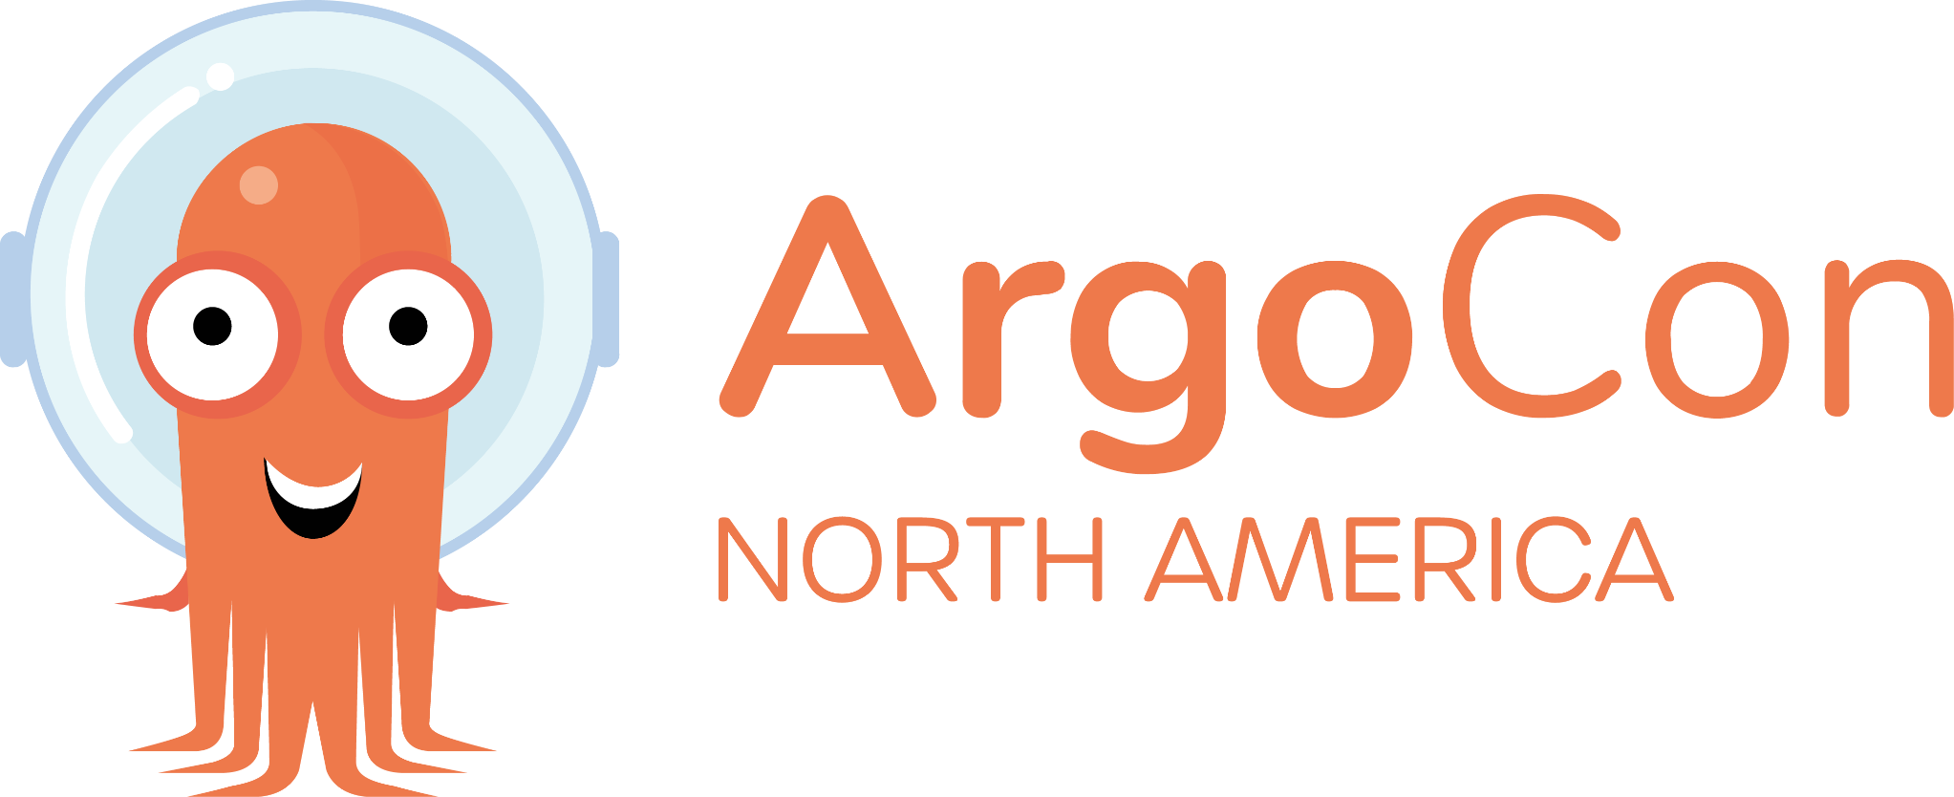
We all have a “friend” who trusts AI code,
perhaps a little too much
42%
1.7x
43%
of code is AI-assisted
more issues per AI PR
of AI changes need debugging
Sonar 2026: 42% of committed
code is AI-generated or assisted
CodeRabbit, 470 PRs: 10.83
issues vs 6.45 for humans
Lightrun 2026: in production,
after passing QA
Sonar, 8 Jan 2026
https://www.sonarsource.com/blog/state-of-code-developer-survey-report-the-current-reality-of-ai-coding
CodeRabbit, 17 Dec 2025
https://www.coderabbit.ai/blog/state-of-ai-vs-human-code-generation-report
Lightrun, 14 Apr 2026
https://venturebeat.com/technology/43-of-ai-generated-code-changes-need-debugging-in-production-survey-finds
Notes:
This is the friend. The one who merges the agent's PR because the tests are green and the diff looks reasonable. The numbers are not an argument against AI-written code; they are an argument that review and unit tests are no longer the bottleneck. Sonar measures 42% of committed code as AI-generated or assisted. CodeRabbit looked at 470 open-source PRs and found AI-authored ones carry about 1.7x more issues. Lightrun's 2026 survey found 43% of AI changes needed manual debugging in production after passing QA.

Slide 3



Three pushes to everyone at once
Cloudflare
CrowdStrike
Knight Capital
18 November 2025
19 July 2024
1 August 2012
One generated feature file,
pushed to every data centre
One rapid-channel sensor update,
pushed to every host
New code on 7 of 8 servers,
one left on the old code
3h02m
8.5M
$460M
of customer impact
Windows devices
lost in 45 minutes
First errors 11:28, core traffic
normal at 14:30
$5.4B in direct losses
across the Fortune 500
SEC fined Knight $12M for the release
Cloudflare, 18 Nov 2025
https://blog.cloudflare.com/18-november-2025-outage
CrowdStrike, 24 Jul 2024
https://www.reuters.com/technology/fortune-500-firms-see-54-bln-crowdstrike-losses-says-insurer-parametrix-2024-07-24/
SEC, 16 Oct 2013
https://www.sec.gov/newsroom/press-releases/2013-222
Notes:
Option A for the outage slide: three cards, evidence first. Cloudflare's own postmortem: a database access control change at 11:05 generated a bad Bot Management feature file that reached customer environments at 11:28; core traffic was mostly normal by 14:30, everything at 17:06. CrowdStrike: one rapid-channel update to 8.5 million Windows devices, $5.4B of direct losses across the Fortune 500 according to Parametrix, reported by Reuters. Knight Capital: new code deployed to seven of eight servers in 2012, $440M lost in 45 minutes, $12M SEC penalty. All three shipped to the whole fleet in one step.

Slide 4
Anatomy of a bad deploy
11:05
11:28
13:05
14:30
17:06
Change deployed
Impact starts
Rollback begins
Core traffic normal
All clear
Database access control
change
Bad feature file reaches
every network
Feature file reverted
to earlier version
Most services back
Every Cloudflare
system normal
3h02m of customer impact
1h37m to rollback
Source: https://blog.cloudflare.com/18-november-2025-outage
Notes:
Option B for the outage slide: one incident as a timeline. Walk the five timestamps slowly. The change landed at 11:05 and looked fine. Impact started at 11:28, when the bad file propagated to customer environments. They rolled back from 13:05 and core traffic was normal at 14:30. All clear at 17:06. Three hours and two minutes of customer impact, and that is a good outcome for an outage this size. CrowdStrike and Knight are the same shape at bigger scale.

Slide 5
CI was green, but production is 20% slower
What CI sees
What production sees
zsh — quarkus-demo
p95 latency (ms)
stable, v3
50ms
$ mvn verify
+20%
[INFO] Tests run: 214, Failures: 0
canary, v4
60ms
[INFO] Errors: 0, Skipped: 4
0
20
40
60
80
[INFO] BUILD SUCCESSFUL in 42s
99% success, zero error logs, no alert
Notes:
This is the demo's fourth image, the one with the slow-burn latency drift. The build is green: 214 tests, no failures, 42 seconds. The service returns 200s and logs nothing alarming. It adds five milliseconds of delay per second of uptime, capped at 250ms, so early in the rollout it looks identical to stable. Forty seconds later p95 is five times the baseline. A unit test cannot see that, and neither can a log parser. Only a comparison against the stable version under real traffic can.

Slide 6
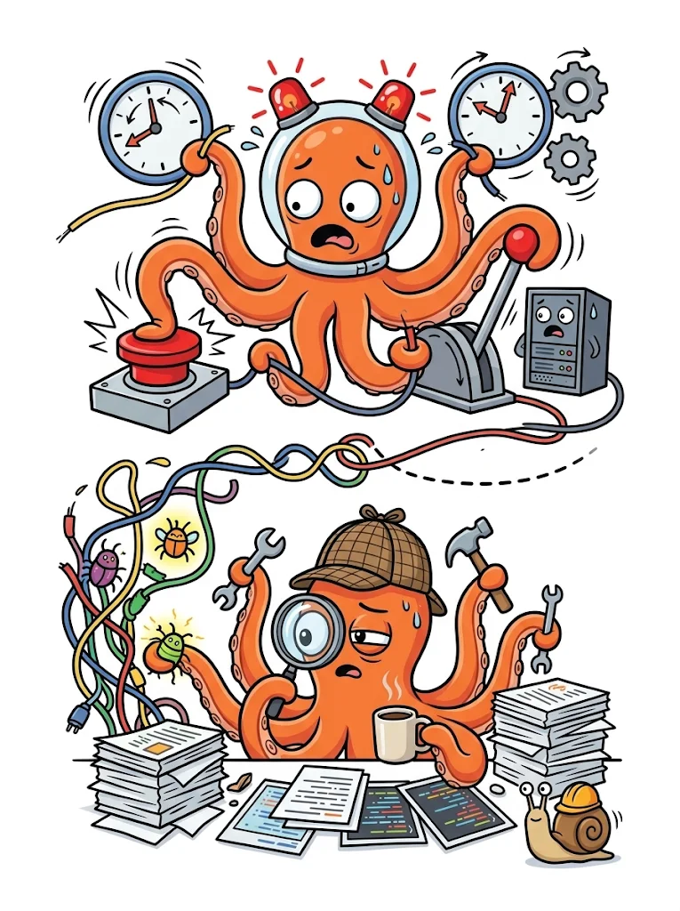
Rollback vs recovery
minutes
1
Detect
to notice
An alert fires and someone opens the dashboard
seconds
2
Roll back
to stop the bleeding
Argo Rollouts aborts to the last stable ReplicaSet
hours
3
Diagnose
to understand
Logs, metrics, the diff, a local repro
days
4
Fix and ship
to actually fix it
Patch, test, review, release
DORA 2025: 21.3% of teams recover in under an hour, 43.4% take more than a day
https://dora.dev/research/2025/dora-report/
Notes:
The slide is about where the time actually goes. Detection and rollback are solved problems: Argo Rollouts aborts in seconds. Everything after that is still human work, and DORA's 2025 report shows the distribution: 21.3% of teams recover in under an hour, 35.3% take between an hour and a day, and 43.4% take more than a day. Rollback closes the incident. The fix is the part nobody automated, and it is the part this talk is about.

Slide 7
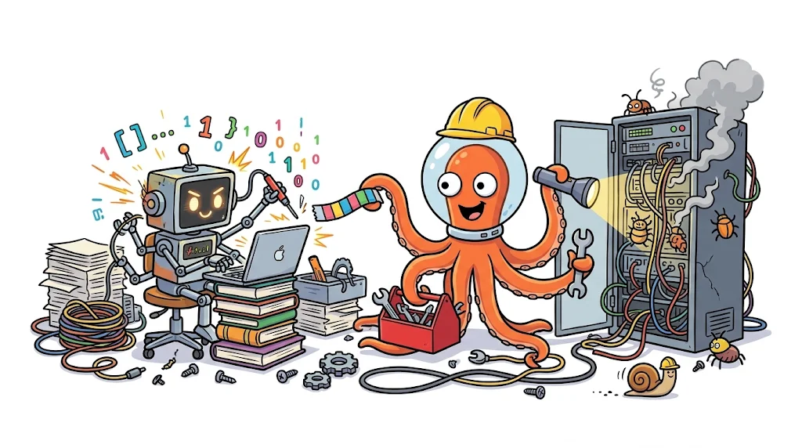


Why an agent should fix it
If it can write the code,
it should be able to write the fix
Logs from the canary
p95 against stable
The diff
A patch
The agent
you review it before it merges
The repo
The test suite
Notes:
The argument in one line, and it is a claim about capability, not about identity. It does not have to be the model that wrote the bug, and it does not have to be the same model twice. Any coding agent given the right evidence can do this. At rollout time it gets what the build never had: the canary's logs, p95 against stable, the diff, the repository, and the test suite. Nothing here needs fine-tuning or a new model. What was missing was never capability, it was context and a trigger, and progressive delivery supplies both.

Slide 8








Rollback ASAP, fix after
DECIDE
synchronous, seconds
in parallel
send for analysis
promote or abort?
Plugin
3 data agents
Analysis
Decision
on rollback
FIX
asynchronous, minutes
handoff
run
report back
A2A call
Sandbox
Agent + tests
PR or issue
Notes:
Two lanes, and the split is deliberate. The top lane is synchronous: the metric plugin calls the analysis agent, three data agents fetch diagnostics, metrics and rollout status in parallel, a combiner merges them, and one model call returns promote or rollback. The rollout waits seconds, not minutes. The bottom lane is asynchronous: when the decision is rollback, the agent sends an A2A message to the remediation service and returns immediately. The fix runs in the background and ends as a pull request or an issue.

Slide 9
Rollouts calls the agent as a plugin
analysistemplate-ai-agent.yaml
- name: ai-analysis
failureLimit: 0
count: 2
interval: 30s
initialDelay: 5s
provider:
plugin:
argoproj-labs/metric-ai:
agentUrl: http://kubernetes-agent:8080
stableLabel: role=stable
canaryLabel: role=canary
1
failureLimit: 0
1
One failed measurement aborts
2
Two measurements
2
Logs early and metrics later
3
Plugin provider
3
No fork and no new CRD
Notes:
This is the whole integration: an AnalysisTemplate that names a metric provider plugin. Argo Rollouts already knows how to run the analysis, retry it, and abort the rollout when it fails. We add a provider, not a fork. failureLimit zero means a single failed measurement aborts. Two measurements, thirty seconds apart, cover both early log-visible bugs and slower metric drift. The agent URL is the only required setting.

Slide 10
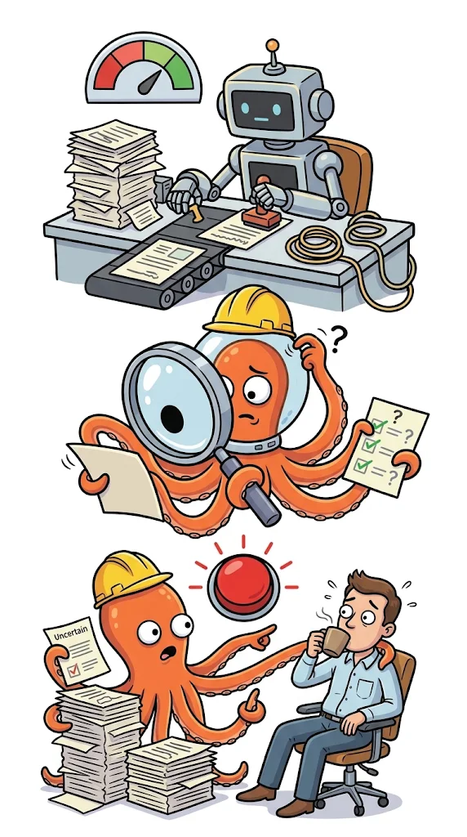




Double & triple check uncertainty
First analysis
Graded by a decision model
below the confidence threshold
50
Routed to a second opinion
still below the confidence threshold
50
Pause, escalate to a human
Notes:
The abstract promised configurable human approval gates, and this is the path behind that promise. The first analysis returns a verdict with a confidence. A decision model grades that verdict against the evidence it actually cited. If the grade lands below the quality threshold, the analysis is routed to a second-opinion model, which re-runs it over the same diagnostics and usually raises the score, but if it still lands below the threshold the rollout pauses and a human gets to promote or abort. Both the pause and the threshold are opt-in fields in the AnalysisTemplate, so a team that wants none of this keeps the plain behaviour.

Slide 11

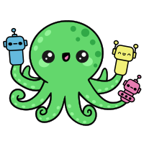
Remediation in Agent Sandbox
Sandbox
Code assistant
Remediation
needed
A pull request
reads the evidence, writes a patch
and runs the tests
green opens a PR
red opens an issue
no cluster credentials and an egress allowlist
Already on Kubernetes
Agent Sandbox
Agent Substrate
Kubernetes SIG Apps, one pod per agent
CNCF sandbox, many agents per node
Agent Sandbox: agent-sandbox.sigs.k8s.io
Agent Substrate: github.com/agent-substrate/substrate
Notes:
One picture, because the point is simple: the code the agent writes runs somewhere disposable. It has no cluster credentials, so a prompt-injected agent has nothing to ask the API server for, and it can only reach an egress allowlist, so it has nowhere to call. The pull request is the only thing that leaves. Agent Sandbox is the Kubernetes SIG Apps project that made this shape standard, one pod per agent; Agent Substrate takes the other bet, many agents packed onto a few nodes because most of them are idle. Pick whichever matches how many agents you run. The box is the same.

Slide 12
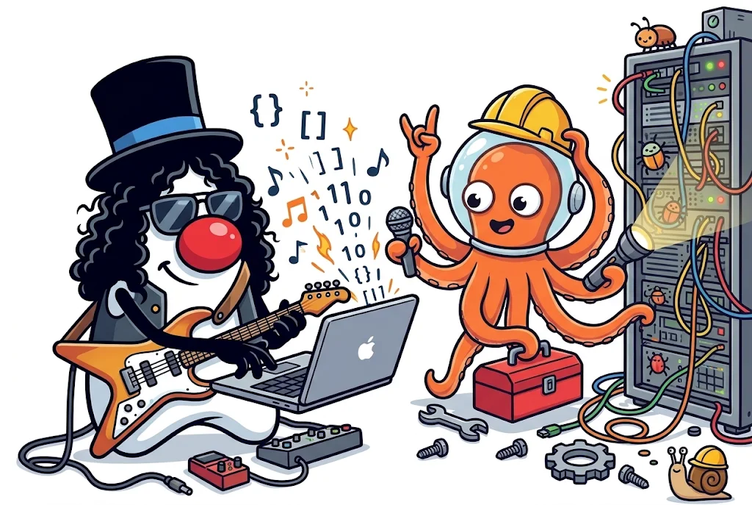


The implementation
Java !?!?
Quarkus
LangChain4j
Notes:
Why Java, in one breath: the services this agent fixes are Java, so the fixer speaks the same language as the thing it repairs. No new runtime to operate, no second toolchain in CI, and the team that reviews the pull request can read the code that wrote it. Quarkus is the runtime, chosen because it starts fast and takes little memory in the cluster next to the rollout controller. LangChain4j is the agent library: @SequenceAgent and @ParallelAgent are interfaces with typed parameters, not prompt strings in a script, and the same annotations give you the A2A server and client, CDI injection, config, health checks and OpenTelemetry. Both are open source.

Slide 13
Agentic workflows as typed interfaces
AnalysisOrchestratorAgent.java
@SequenceAgent(
description = "Complete Kubernetes rollout analysis workflow",
outputKey = "analysisResult",
subAgents = {
AnalysisDataAgent.class,
DataCombinerAgent.class,
AnalysisAgent.class
}
)
ResultWithAgenticScope<AnalysisResult> execute(
String message,
String namespace,
String stableSelector,
String canarySelector
);
1
@SequenceAgent
1
The annotation declares the order
2
Three sub-agents
2
Two fetch data and one decides
3
The result is a record
3
fields the gate can score
Notes:
Fifteen lines, and none of it is prose. @SequenceAgent declares the order: the data agent, the combiner, the analysis agent. The data agent fans out to diagnostics, metrics and rollout status in parallel, and only the last agent calls a model. The return type is an AnalysisResult record, promote, confidence, root cause, suspect classes, so the model's answer arrives as fields the gate can score, not a paragraph someone has to parse. The agentic scope wrapper also carries the intermediate evidence, which is what the grader scores the conclusion against. The interface is a bean, so the whole workflow is mockable in tests.

Slide 14
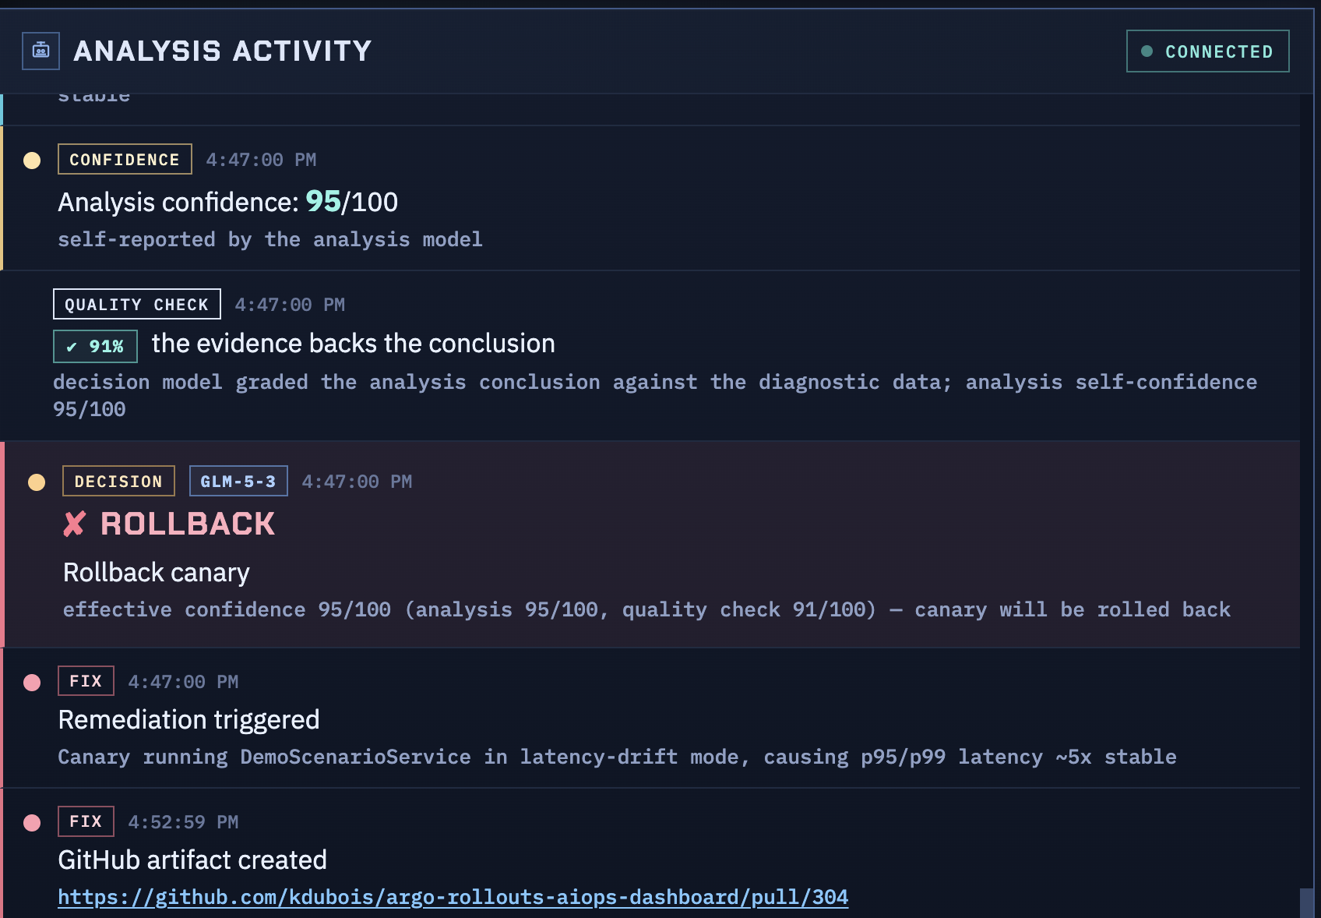
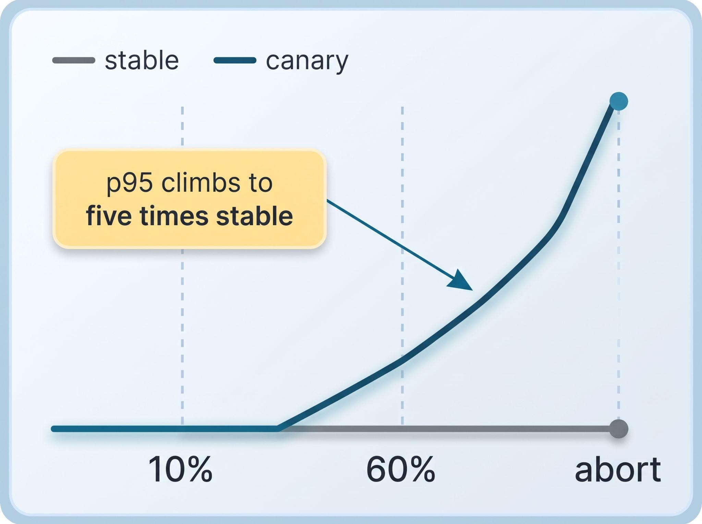
Demo time !!
Notes:
Switch to the cluster here. Two lines on the picture, and only one of them moves: the canary holds stable until the rollout reaches sixty percent, then p95 climbs to five times the stable value while the success rate stays at ninety-nine and the logs stay clean. That is the whole point of the demo, so point at the flat part first and say it looks fine. Everything after that is the machine noticing what the logs did not. If the cluster misbehaves, fall back to the recorded clip.

Slide 15
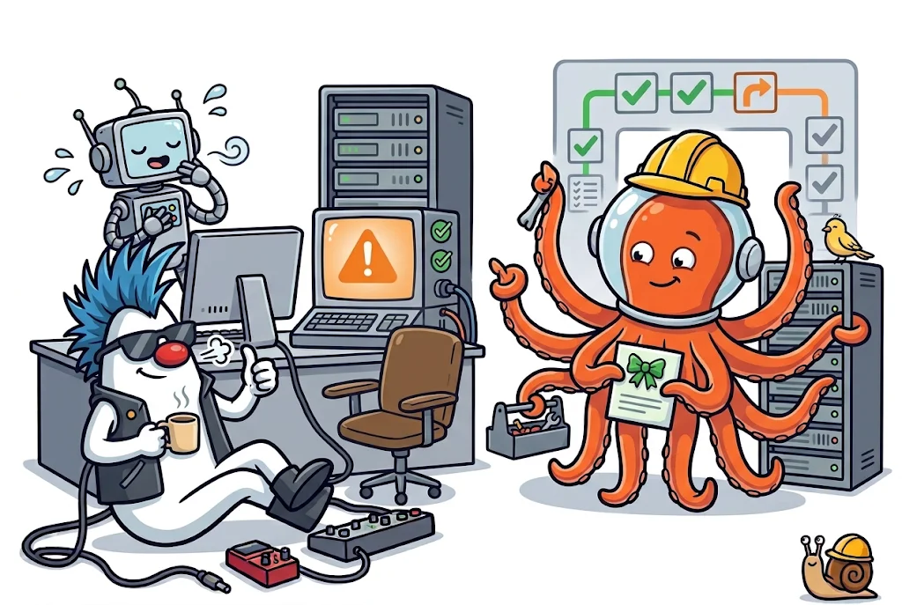
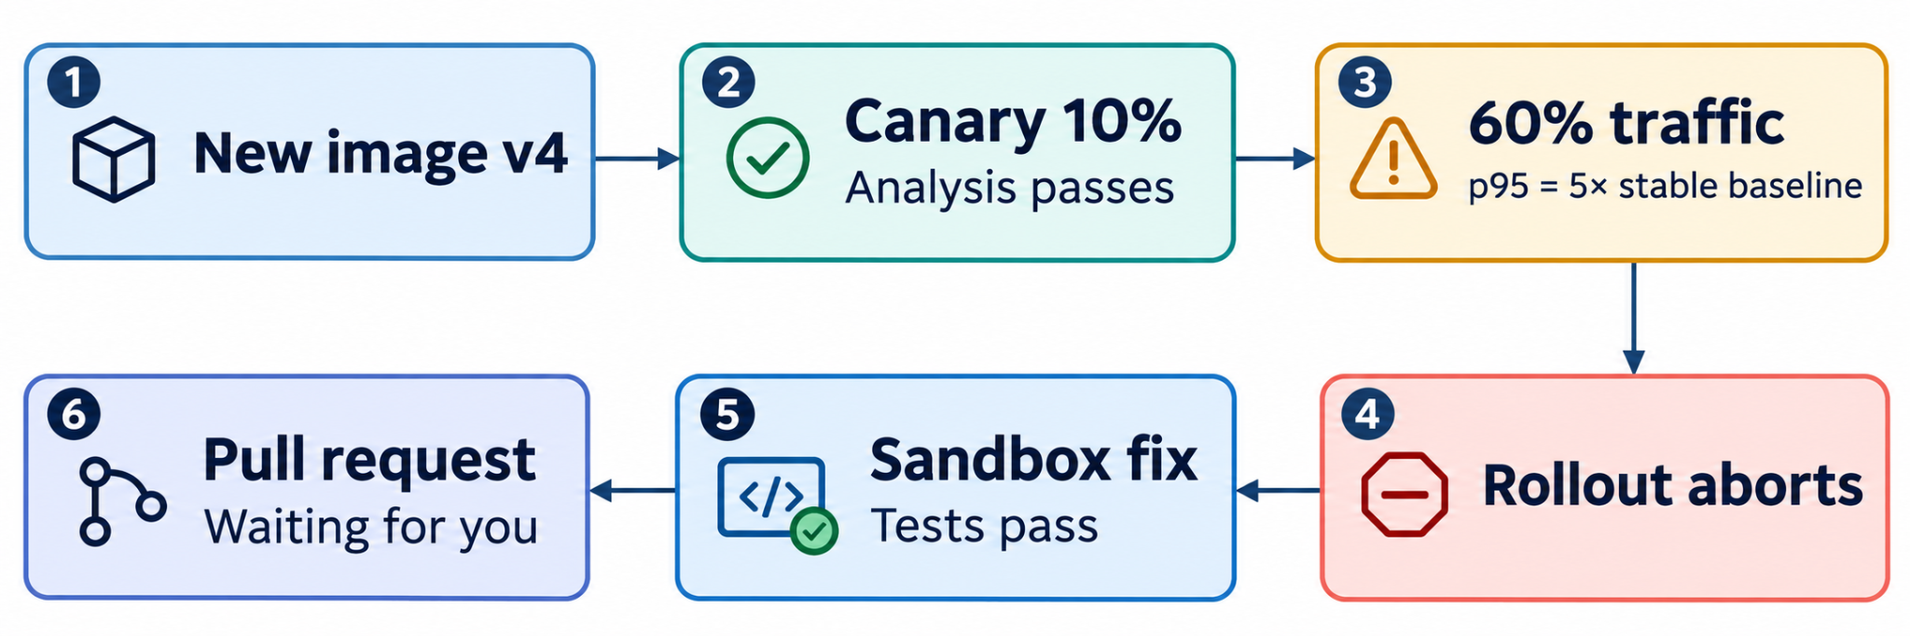
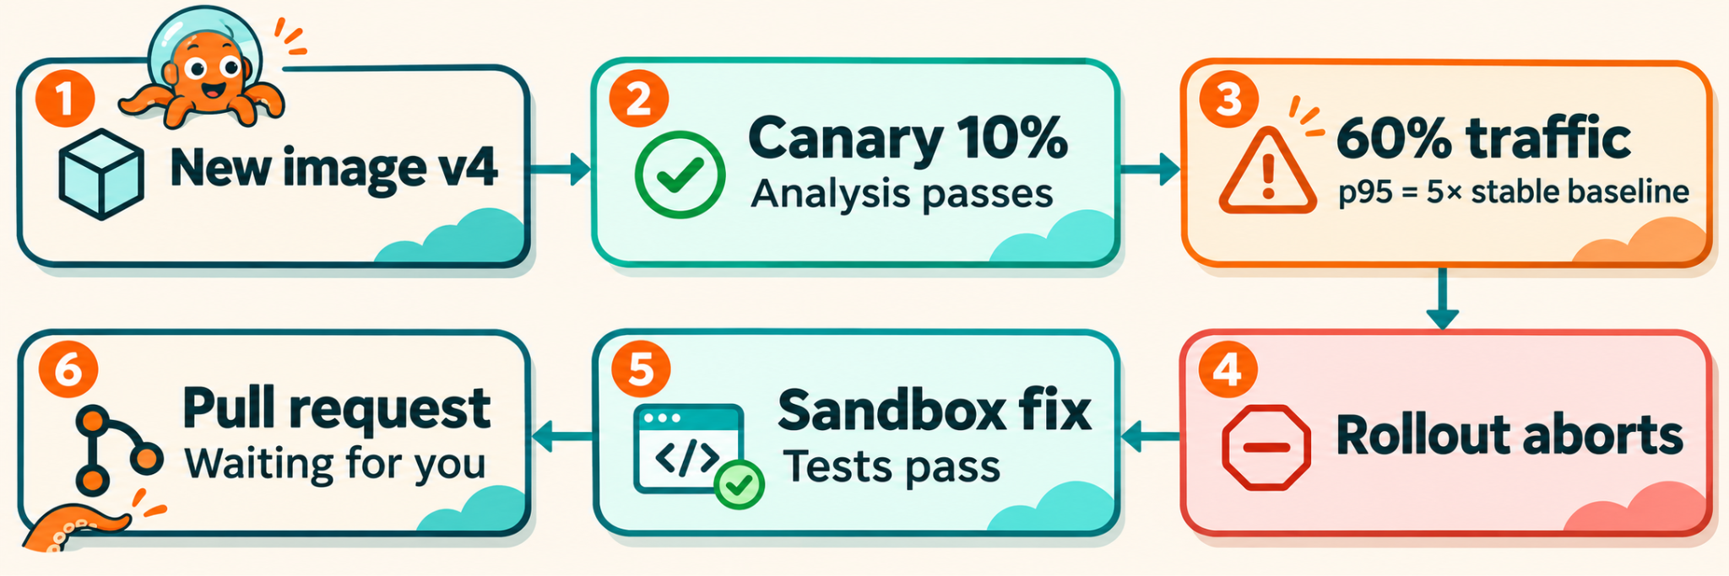
What you just saw (hopefully)
Notes:
The demo in one line, read right to left along the bottom. The first analysis passes at ten percent and nothing looks wrong. At sixty percent p95 climbs to five times the stable value, the second analysis fails, and the controller aborts without anyone typing a command. Then the agent writes the fix in the sandbox, runs the tests, and opens a pull request that waits for a human. That last box is deliberate: nothing merges itself.

Slide 16
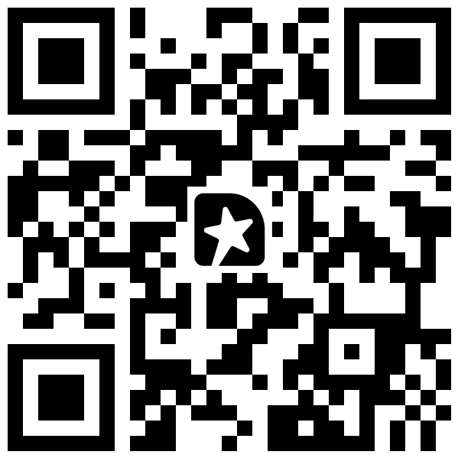
All open source!
THANK YOU
argoproj-labs/rollouts-plugin-metric-ai
The Argo Rollouts metric provider that calls it
Keep the rollout
Add the loop
github.com/kdubois/kubernetes-aiops-agent
The analysis agent and the LangChain4j workflow
github.com/kdubois/remediation-agent
Sandbox, coding agent, pull request or issue
Kevin Dubois
github.com/kdubois linkedin.com/in/kevindubois
Carlos Sanchez
github.com/carlossg linkedin.com/in/carlossg
Session feedback
Scan and rate the talk
Slides: speakerdeck.com/kdubois/the-agent-broke-it-the-agent-fixed-it-dot-pptx
Notes:
Land the ask, then stop talking. Keep progressive delivery, add the step after it: something that reads the evidence and opens a fix. Everything on this slide is public, and the plugin is in argoproj-labs, so anyone can wire it into their own Rollouts install. Point at the QR once, ask for the feedback, and leave it up for questions.

Slide 17
Sources
Cloudflare postmortem, 18 Nov 2025
blog.cloudflare.com/18-november-2025-outage
CrowdStrike losses: Parametrix via Reuters
reuters.com/technology/fortune-500-firms-see-54-bln-crowdstrike-losses-says-insurer-parametrix
SEC order against Knight Capital
www.sec.gov/newsroom/press-releases/2013-222
DORA 2025 report
dora.dev/research/2025/dora-report/
Sonar, State of Code 2026 (Jan 2026)
www.sonarsource.com/blog/state-of-code-developer-survey-report-the-current-reality-of-ai-coding
CodeRabbit, AI vs human code
coderabbit.ai/blog/state-of-ai-vs-human-code-generation-report
Lightrun survey, via VentureBeat
venturebeat.com/technology/43-of-ai-generated-code-changes-need-debugging-in-production-survey-finds
Quarkus benchmarks vs Spring Boot
quarkus.io/blog/new-benchmarks
Agent Sandbox, Kubernetes SIG Apps
agent-sandbox.sigs.k8s.io
Agent Substrate, CNCF sandbox
github.com/agent-substrate/substrate
Notes:
Appendix, not presented. Every number on the slides traces to one of these. The DORA figure is the 2025 report: 21.3% under an hour, 35.3% between an hour and a day, 43.4% more than a day. The Cloudflare times come from their own postmortem timeline. The CrowdStrike loss estimate is Parametrix's, reported by Reuters, not CrowdStrike's.

